Slide 1

Enhancing Cybersecurity in Fleet Management Systems using Runtime Verification and Hardware-Assisted Encryption.
Damian Navarro

Slide 2
Why Runtime Verification?
Runtime verification is the technique by which a system is monitored whilst running to ensure proper behaviour based on properties defined by the developer.
In a fleet of cars, records will be continuously received containing important information such as location readings and car diagnostics.
Given these records are being transmitted between components, there are weak points which may be leveraged by bad actors to alter and read this sensitive information.
Runtime Verification is used to detect tampering on said records and prevent any malicious or corrupted data from entering the system.

Slide 3
Runtime Verification Properties for our scenario
In our case, we are testing for 5 runtime verification properties to ensure data integrity. To do so, we compare the most recently received record with the previously received record. We test for the following:
  Invalid Timestamp
  Abnormal change in GPS
  Abnormal change in Velocity
  Invalid GPS information
  Engine OFF but GPS reports movement

Slide 4
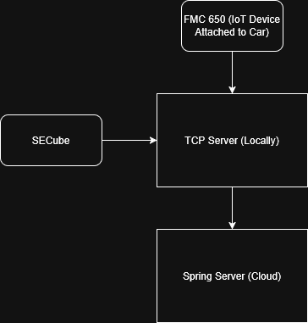
The setup
Component Diagram
The Concept
FMC650 IoT Device attached to car records Location and ECU Data and transmits to Local TCP Server
Local TCP Server Ensures validity of received records through Runtime Verification
Local TCP Server Encrypts the records and RV result using Encryption Key stored in SECube Hardware Security Module
Local TCP Server transmits the Data to a cloud Spring Server which repeats the Runtime Verification process and Logs the Record + Result

Slide 5
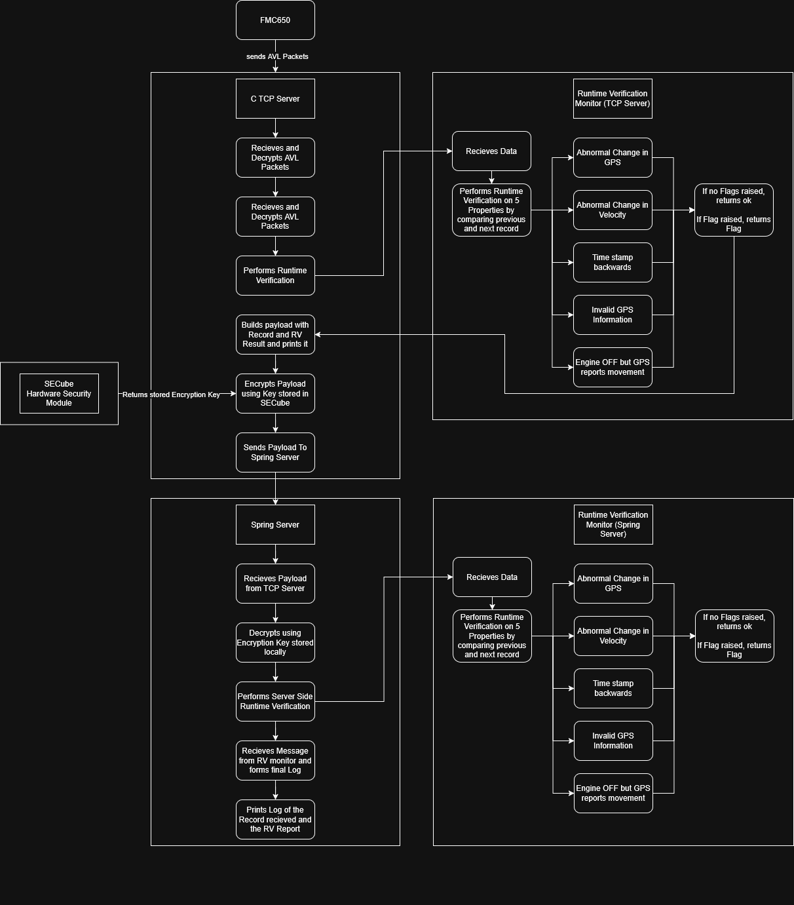
Activity Diagram

Slide 8
Next Steps
Implement further RV properties both on the TCP server and the Spring Server
Switch Spring Server to use the LARVA Runtime Verification library for better Runtime Verification
Collect diagnostic data of our setup for analysis

